Slide 1
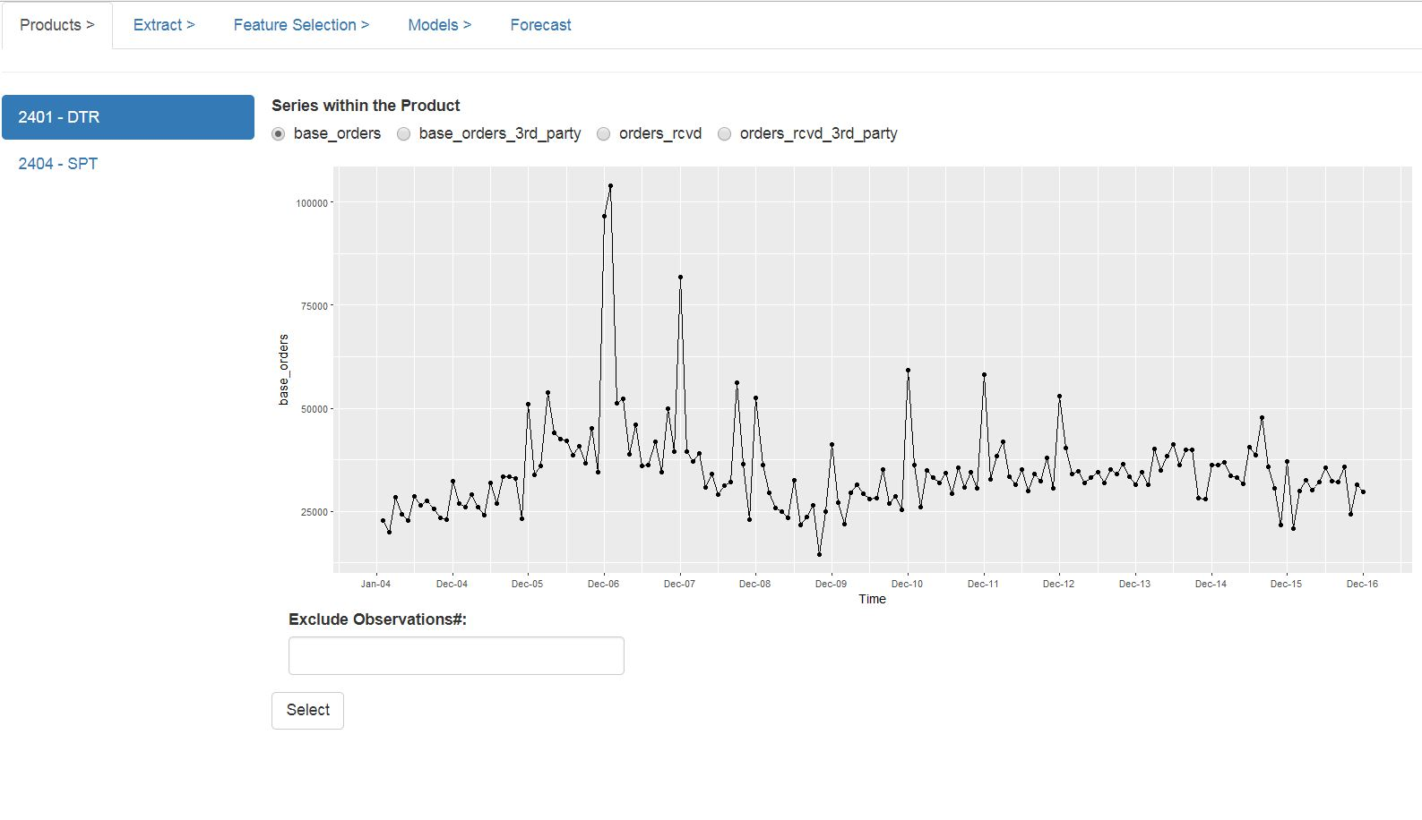
Step 2: Select the revenue type
Step 3 [Optional] : Select observations to be excluded by
clicking on the data points. Such points
would be listed in the “exclude observations#”
box.
Step 1: Select Product
Line
Step 4: Finalize the selection

